Slide 1
BCG 호흡 심박 추출 알고리즘
2021. 01. 14.
Hyunsoo, Yu

Slide 2
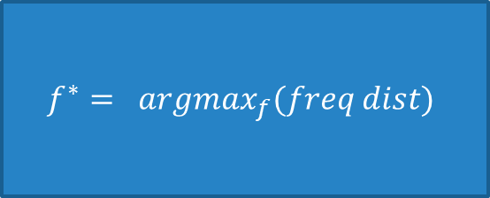
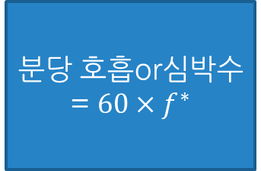
mechanism
Raw data
Filtering(Bandpass) ^{[1]}
Heart Rate : 0.16~0.66Hz
Respiration : 0.83~2.5Hz
FFT
$$f^{∗}= argmax_{f}(freq dist)$$
분당 호흡or심박수 = $60×f^{∗}$
※ freq dist : FFT의 결과로 나온 주파수 분포도
[1] Wusk G, Gabler H. Non-Invasive Detection of Respiration and Heart Rate with a Vehicle Seat Sensor. Sensors (Basel). 2018;18(5):1463. Published 2018 May 8. doi:10.3390/s18051463

